Slide 1

Intro to Big Data Technologies

Slide 2
Hadoop as a Terminology
Vertical scalability vs Horizontal Scalability
Cost vs Performance Curve
Huawei CEM Shared Nothing Architecture
Write once read multiple

Slide 3
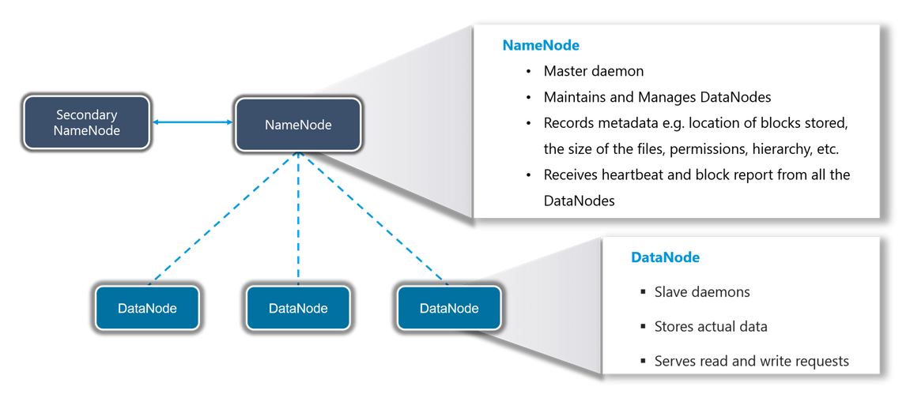
HDFS

Slide 4
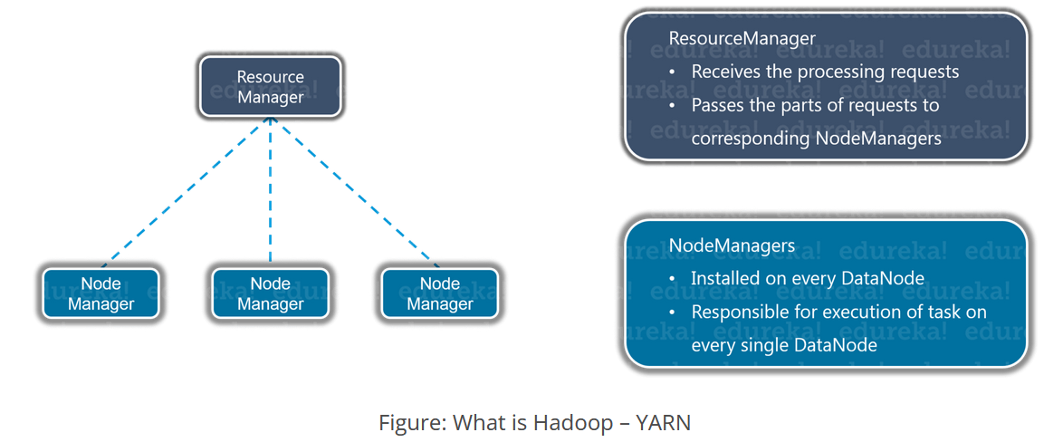
YARN

Slide 5
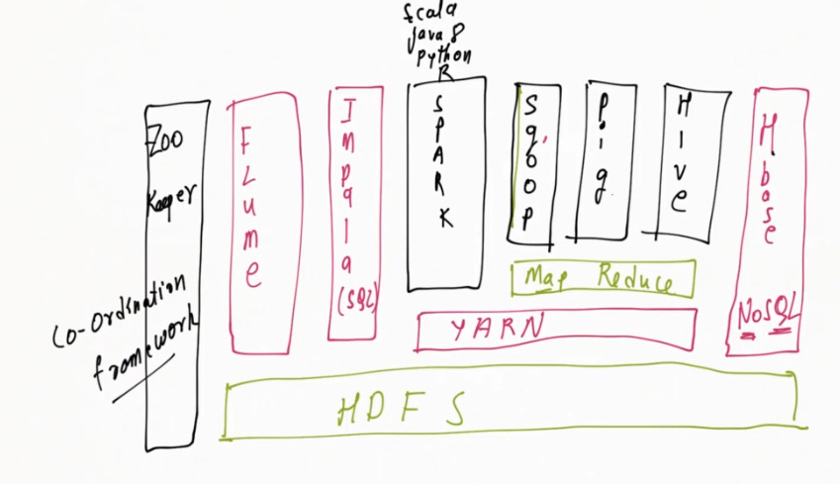
Related Distributions, Applications & Services

Slide 6
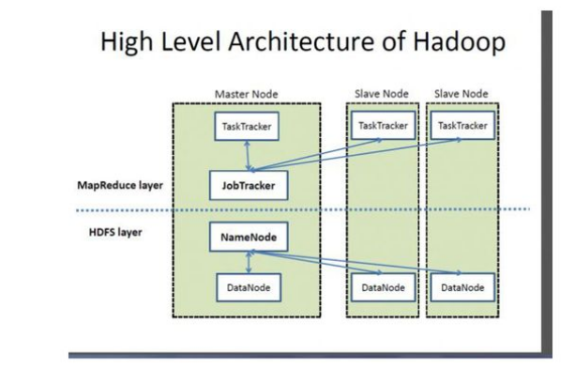
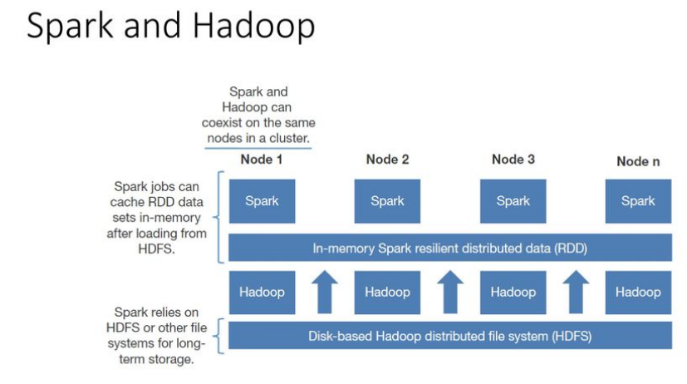
Baseline Architecture

Slide 7
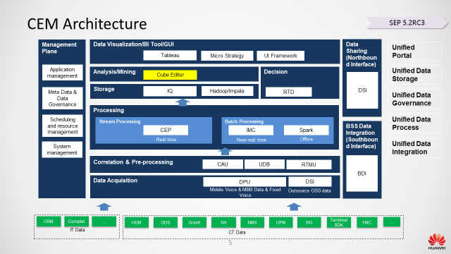
Huawei CEM
HW Fusion Insights
HDFS

